Slide 1
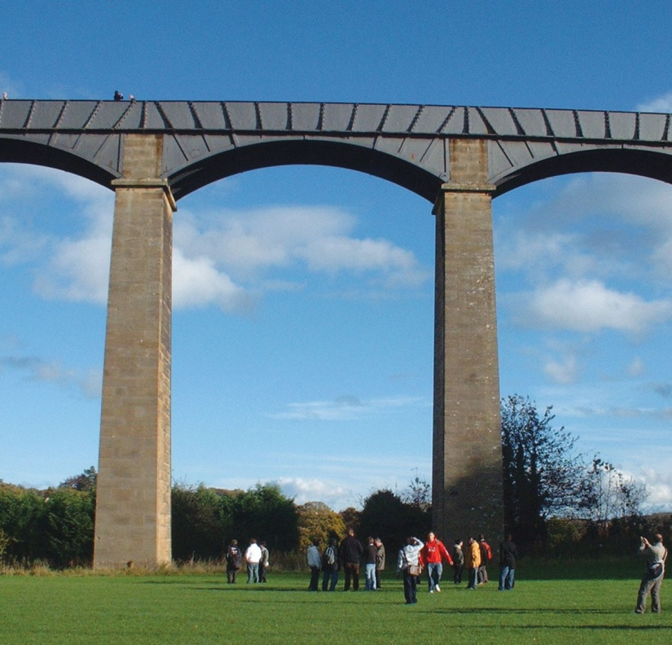
FIGURE 34.1 Students Below the Pontcysyllte Aqueduct, Built in 1805 to Carry the Llangollen Canal Over the
River Dee Valley in Wales
Copyright © 2016 Elsevier Ltd. All rights reserved.

Slide 2
FIGURE 34.2 Length/Width/Height Ratios for Bricks
Copyright © 2016 Elsevier Ltd. All rights reserved.

Slide 3
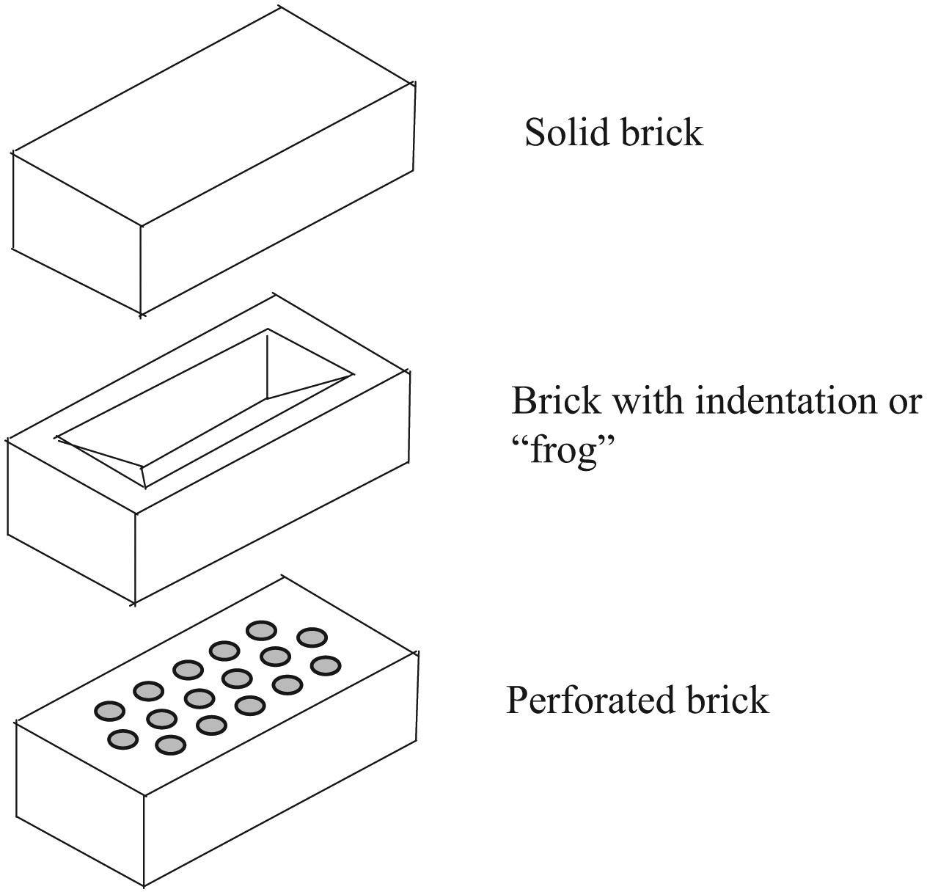
FIGURE 34.3 Common Brick Shapes
Copyright © 2016 Elsevier Ltd. All rights reserved.

Slide 4
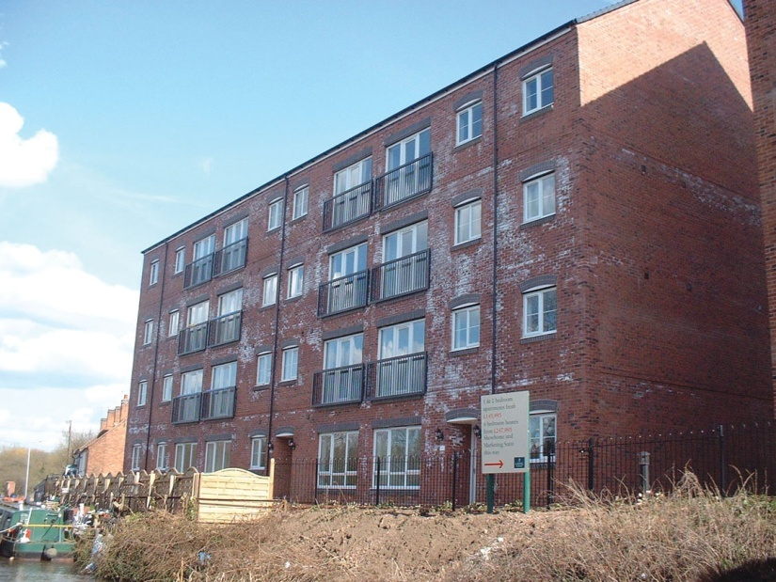
FIGURE 34.4 Severe Effl orescence on New Brickwork
Copyright © 2016 Elsevier Ltd. All rights reserved.

Slide 5
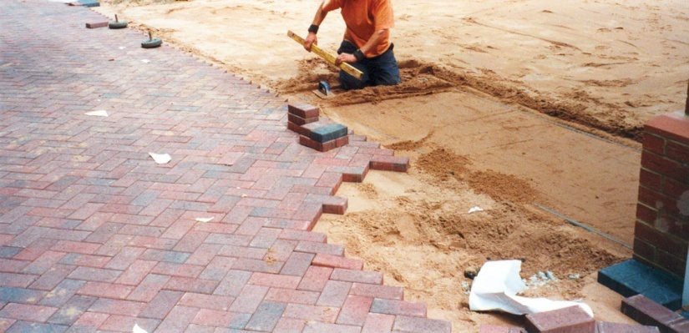
FIGURE 34.5 Brick Paving with Concrete Bricks
Copyright © 2016 Elsevier Ltd. All rights reserved.

Slide 6
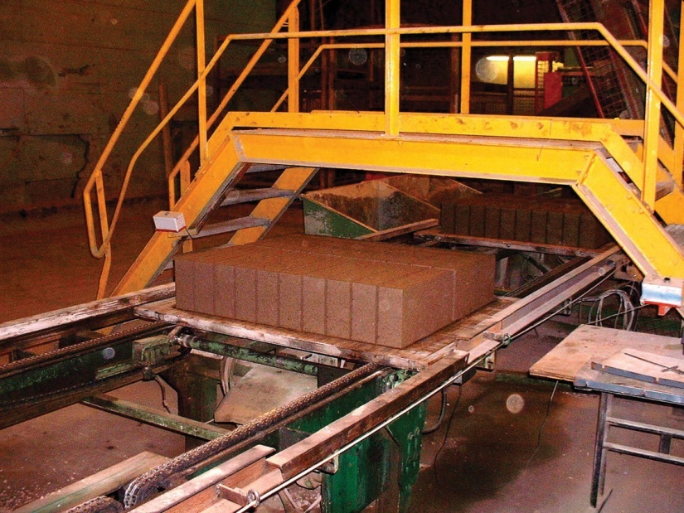
FIGURE 34.6 Production of Aggregate Concrete Blocks
Copyright © 2016 Elsevier Ltd. All rights reserved.

Slide 7
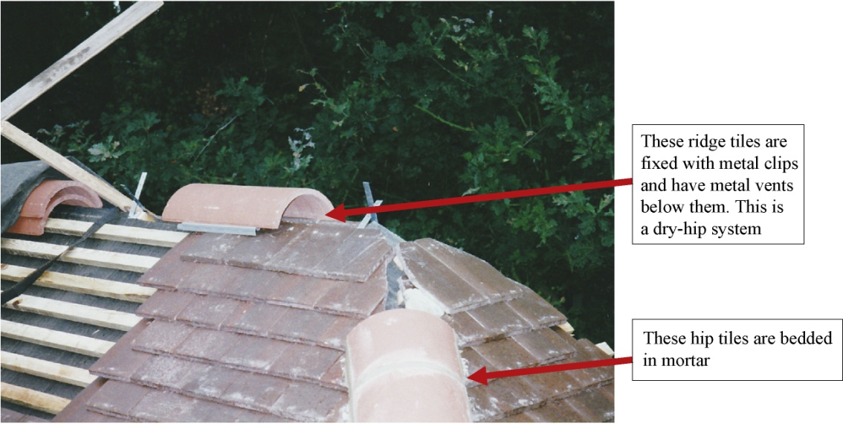
FIGURE 34.7 Clay Tiles
Copyright © 2016 Elsevier Ltd. All rights reserved.

Slide 8
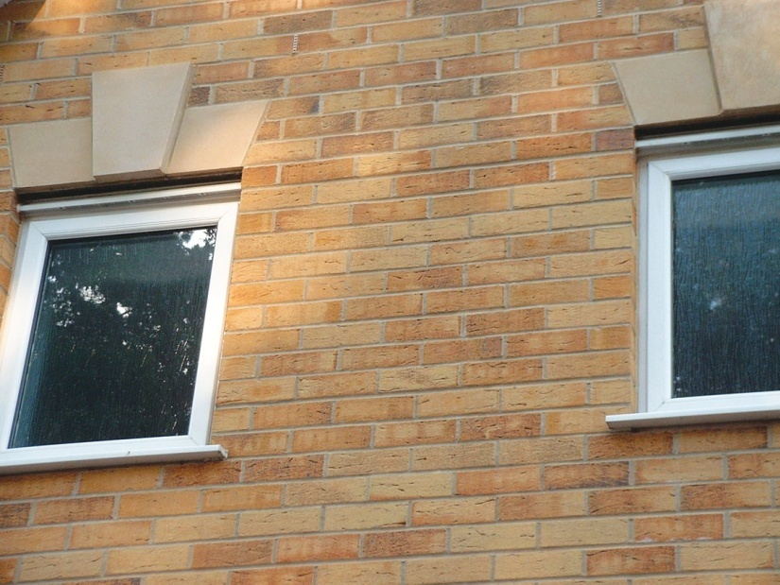
FIGURE 34.8 Well Planned Brickwork
Copyright © 2016 Elsevier Ltd. All rights reserved.

Slide 9
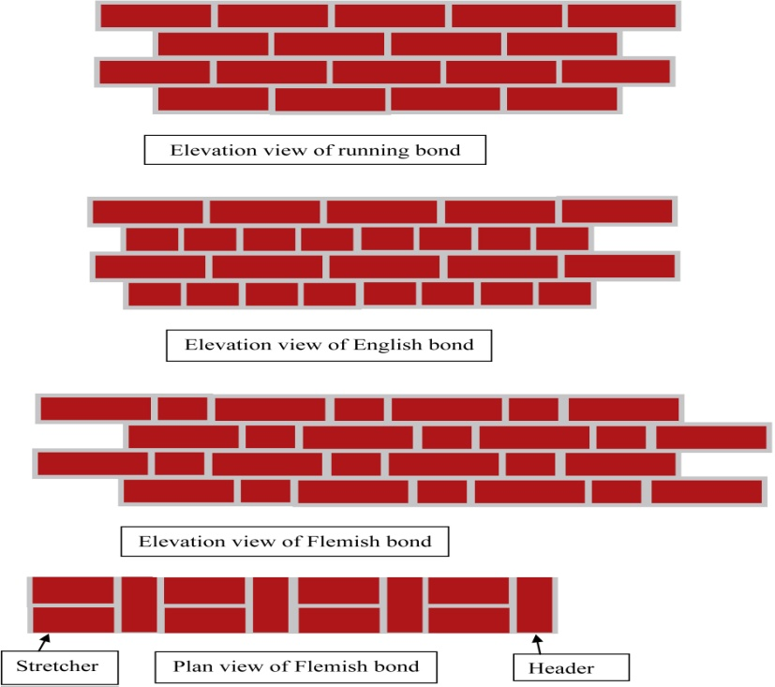
FIGURE 34.9 Bond Details
Copyright © 2016 Elsevier Ltd. All rights reserved.

Slide 10
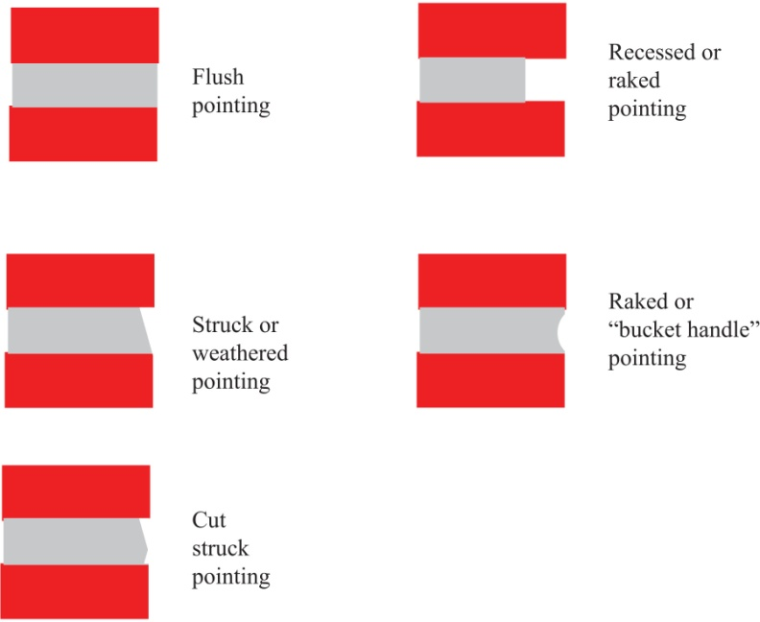
FIGURE 34.10 Pointing Details
Copyright © 2016 Elsevier Ltd. All rights reserved.

Slide 11
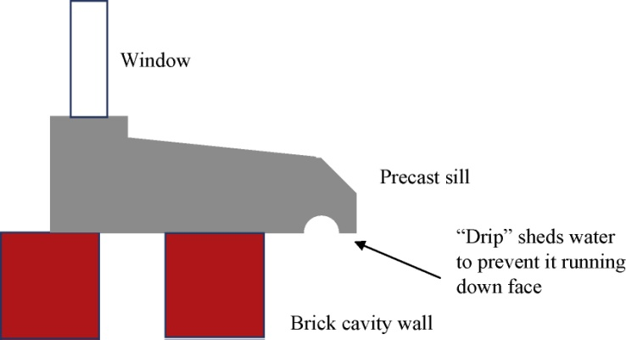
FIGURE 34.11 Sill Detail
Copyright © 2016 Elsevier Ltd. All rights reserved.

Slide 12
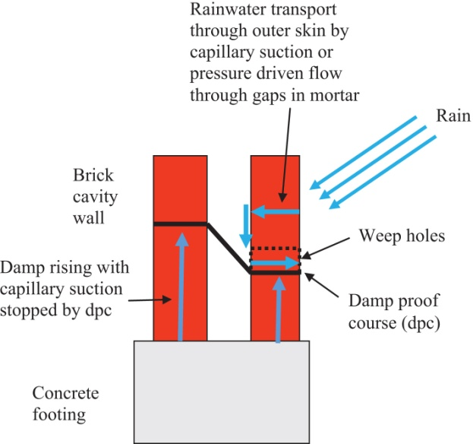
FIGURE 34.12 Brick Wall Detail
Copyright © 2016 Elsevier Ltd. All rights reserved.

Slide 13
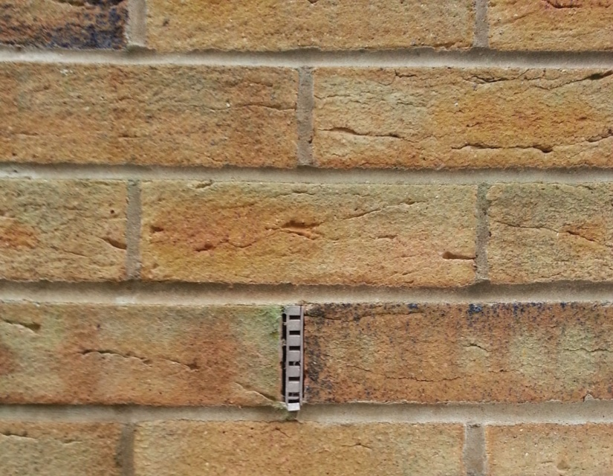
FIGURE 34.13 Weep Hole with Plastic Fitting in it to Keep it Clear
Copyright © 2016 Elsevier Ltd. All rights reserved.

Slide 14
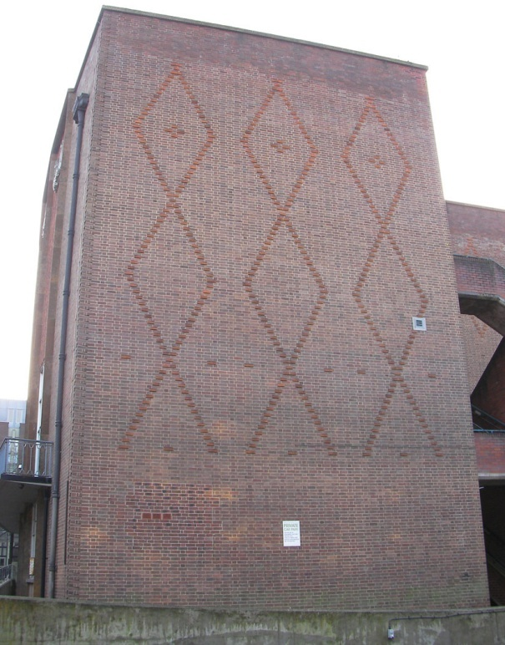
FIGURE 34.14
Copyright © 2016 Elsevier Ltd. All rights reserved.

Slide 15
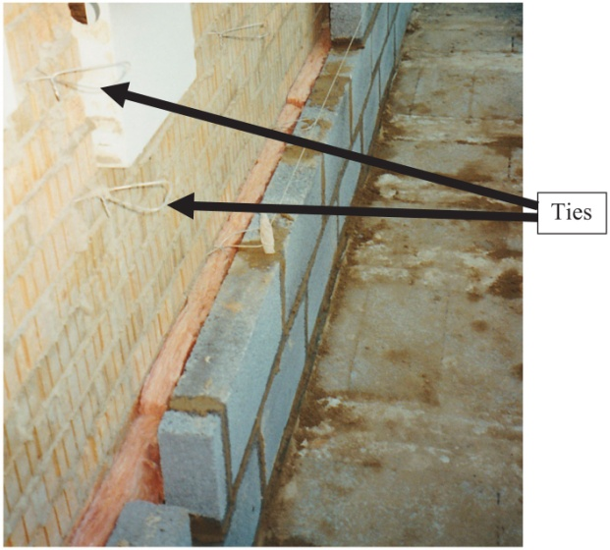
FIGURE 34.15 Cavity Wall Ties
Copyright © 2016 Elsevier Ltd. All rights reserved.

Slide 16
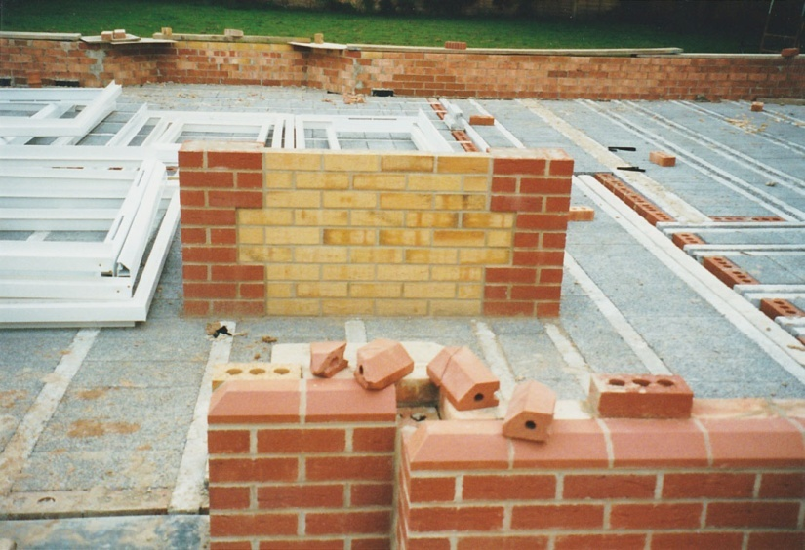
FIGURE 34.16 Sample Panel Built to Include Proposed Features of Finished Work
Copyright © 2016 Elsevier Ltd. All rights reserved.

